Slide 1
Play Store App Review Analysis
DATA ANALYTICS PROJECT
Presented By:
Dayanshi Jain
Maulana Azad National Institute of Technology
Electronics and Communication Department

Slide 2
OUTLINE
Problem Statement
Proposed System/Solution
System Development Approach
Algorithm & Deployment
Result
Conclusion
Future Scope
References

Slide 3
PROBLEM STATEMENT
The data from the Play Store apps holds significant potential for driving success in app-making businesses. It provides actionable insights that developers can use to capture the Android market. Each app entry includes crucial details such as category, rating, size, and more. Additionally, a separate dataset contains customer reviews of these Android apps. Through thorough exploration and analysis of this data, key factors contributing to app engagement and success can be uncovered.

Slide 4
PROPOSED SOLUTION
The proposed system aims to address the challenge of predicting the required bike count at each hour to ensure a stable supply of rental bikes. This involves leveraging data analytics and machine learning techniques to forecast demand patterns accurately. The solution will consist of the following components:
Data Collection - Gather comprehensive data from the Play Store, including app details (category, rating, size, etc.) and customer reviews.
Data Cleaning and Preprocessing - Remove any duplicates, null values, and inconsistencies from the datasets and standardize the data format for consistency.
Data Exploration - Conduct exploratory data analysis (EDA) to identify patterns and insights and also visualize key metrics using graphs and charts to understand distributions and relationships.
Sentiment Analysis:- Analyze customer reviews to determine overall sentiment. Categorize reviews into positive, negative, and neutral sentiments.
Feature Engineering - Create new features from existing data that could contribute to app success, such as average rating over time, review, sentiment score, etc.

Slide 5
Continued…..
Predictive Modeling - Develop machine learning models to predict app success based on features like category, rating, size, and sentiment score. Use techniques like regression, classification, or clustering as needed.
Model Evaluation and Optimization - Evaluate the performance of the models using appropriate metrics (e.g., accuracy, precision, recall).Optimize models by tuning hyperparameters and selecting the best-performing model.
Insights and Recommendations - Derive actionable insights from the analysis and modeling results. Provide recommendations for app developers to improve engagement and success based on identified key factors.
Dashboard Creation - Build an interactive dashboard to visualize key findings and metrics. Allow users to explore data, model predictions, and insights dynamically.

Slide 6
SYSTEM APPROACH
The "System Approach" section outlines the overall strategy and methodology for developing and implementing the “Play Store Rview Analysis” system. Here's a suggested structure for this section:
System requirements : windows 11 operating system , 8GB RAM, I3 Processor
Library required to build the model : IBM Watsonx studio

Slide 7
ALGORITHM & DEPLOYMENT
In the Algorithm section, describe the machine learning algorithm chosen for predicting bike counts. Here's an example structure for this section:
Dataset Preparation:-
Loading the data sets: Two datasets, First Play store app dataset and User Reviews dataset.
Import Libraries: NumPy, Pandas, Seaborn and Matplotlib
Data cleaning: Null values, Finding and removing Outliers, Removing duplicate data.
Data Imputation: Filling the missing categorical values with mode and numerical values with median. Conversion of price, installs, reviews into numerical values.
Exploratory Data Analysis: Analyzing the data sets to summarize their main characteristics using statistical graphics and data visualizations method.

Slide 8
Attributes
App : The name of the app for each observation.
Category : Category to which the app belongs.
Rating : The average rating for the app.
Reviews : The number of reviews that the app has received on the play store.
Size : The amount of memory the app occupies on the device.
Installs : The number of times that the app has been downloaded and installed from the play store.
Type : The information whether the app is free or paid.
Price: If the app is a paid app, the data about its price.
Content Rating: The maturity rating of the app i.e. the age group of the audience for which it is suitable.
Genres: The data about to which genre the app belongs. Genres can be considered as a further division of the group of Category.

Slide 9
Last Updated: The date on which the latest update of the app was released.
Current Version: Information on the current version of the app available on the play store.
Android Version: Information about the android versions on which the app is supported.
Attributes in User reviews
App- Application name
Translated Review- User review
Sentiment- Positive/Negative/Neutral
Sentiment Polarity- Sentiment polarity score
Sentiment Subjectivity- Sentiment subjectivity score

Slide 10



OVERVIEW OF ANALYSIS
Data Cleaning
Data Exploration
Predictive Modeling
Understand the structure of the dataset and clean data before analysis
Uncover initial patterns, characteristics, and points of interest using visual exploration
Formulate a statistical model to forecast an outcome using relevant predictors

Slide 11
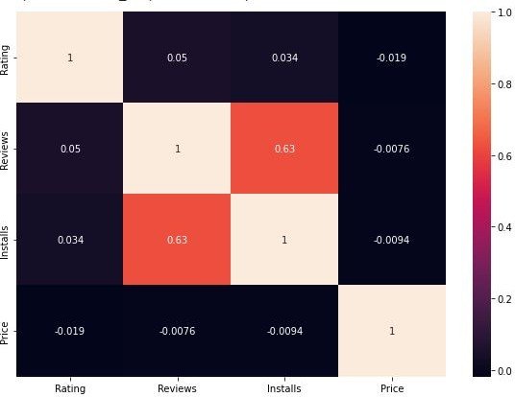
RESULT
Correlation Heatmap
There is a strong positive correlation between the Reviews and Installs
The Price is slightly negatively correlated with the Rating and Review, Installs.
The Rating is slightly positively correlated with the Installs and Reviews.

Slide 12
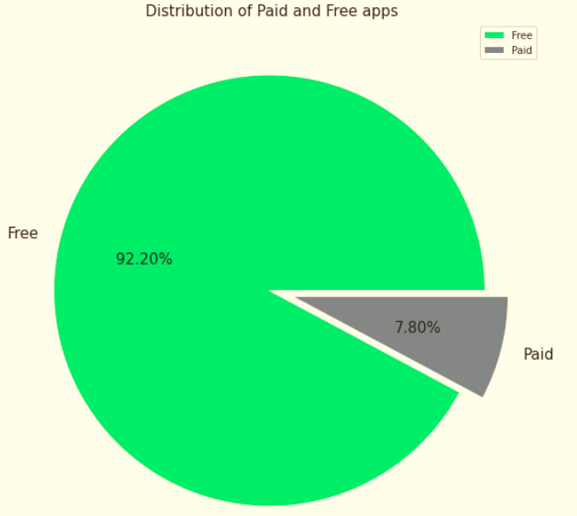
Percentage of Paid apps v/s Free apps
We Observed that 92.20% of Apps are free and only 7.80% of Apps are paid in Play store.

Slide 13
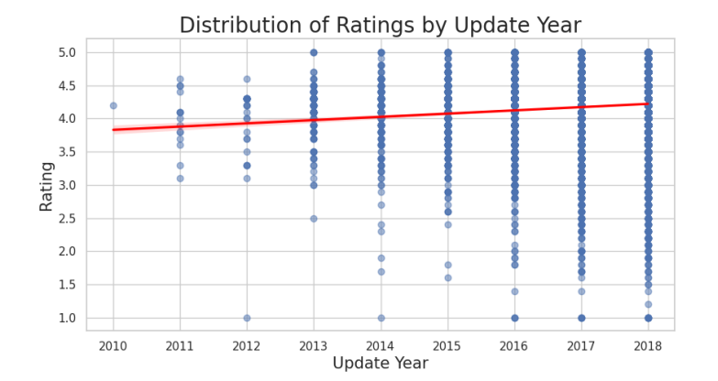
Distribution of Ratings by Update Year
The average rating has shown an improvement, rising from approximately 3.5 in 2010 to nearly 4.5 in 2018. This indicates a general trend of increasing satisfaction among users with the product over the years

Slide 14
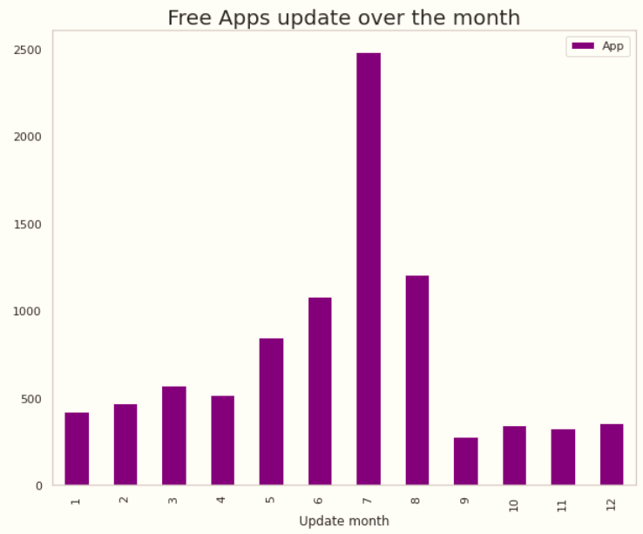
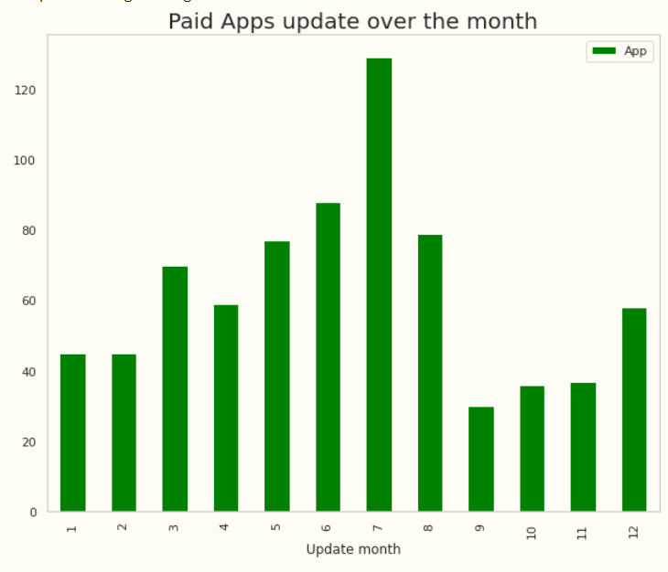
Distribution of Apps updated over the Year and Month

Slide 15
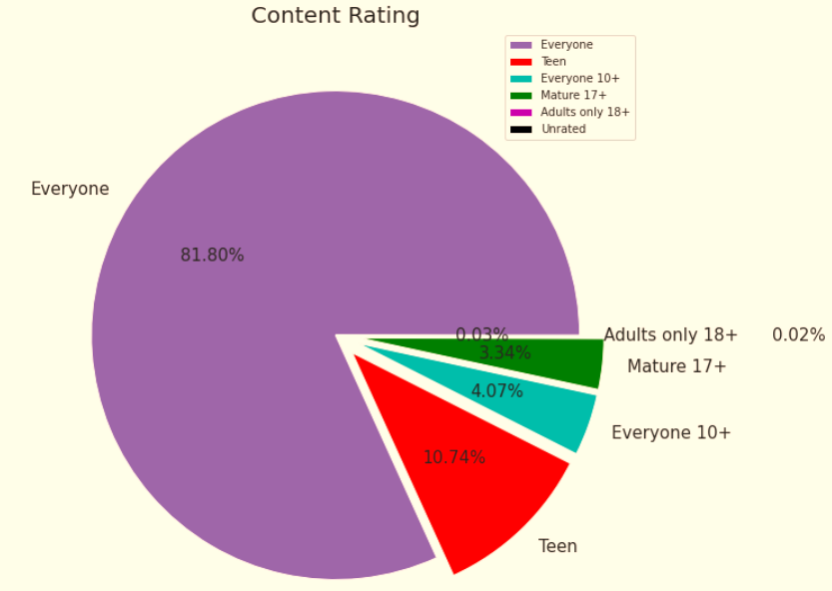
Content Rating
From the above plot we can see that Everyone category having majority of apps count.
A majority of the apps (81.80%) in the play store are can be used by everyone. The remaining apps have various age restrictions to use it.

Slide 16
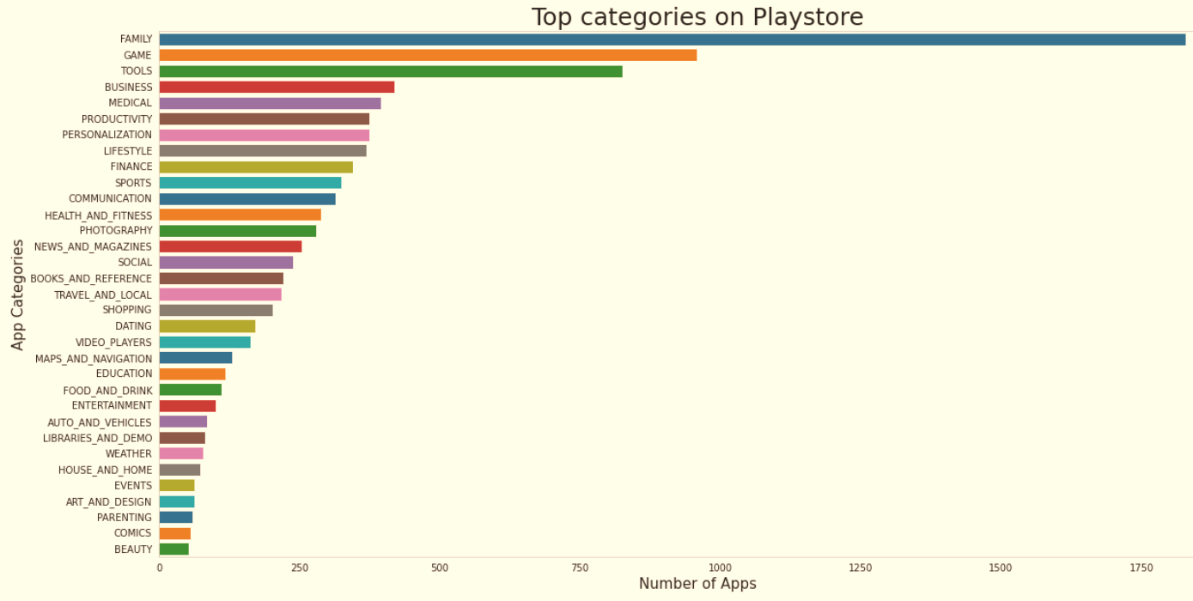
Count of Applications in each category
Family and Game apps have the
highest market prevalence. Surprising Tools, Business and Medical apps are also at the Top Count of applications.

Slide 17
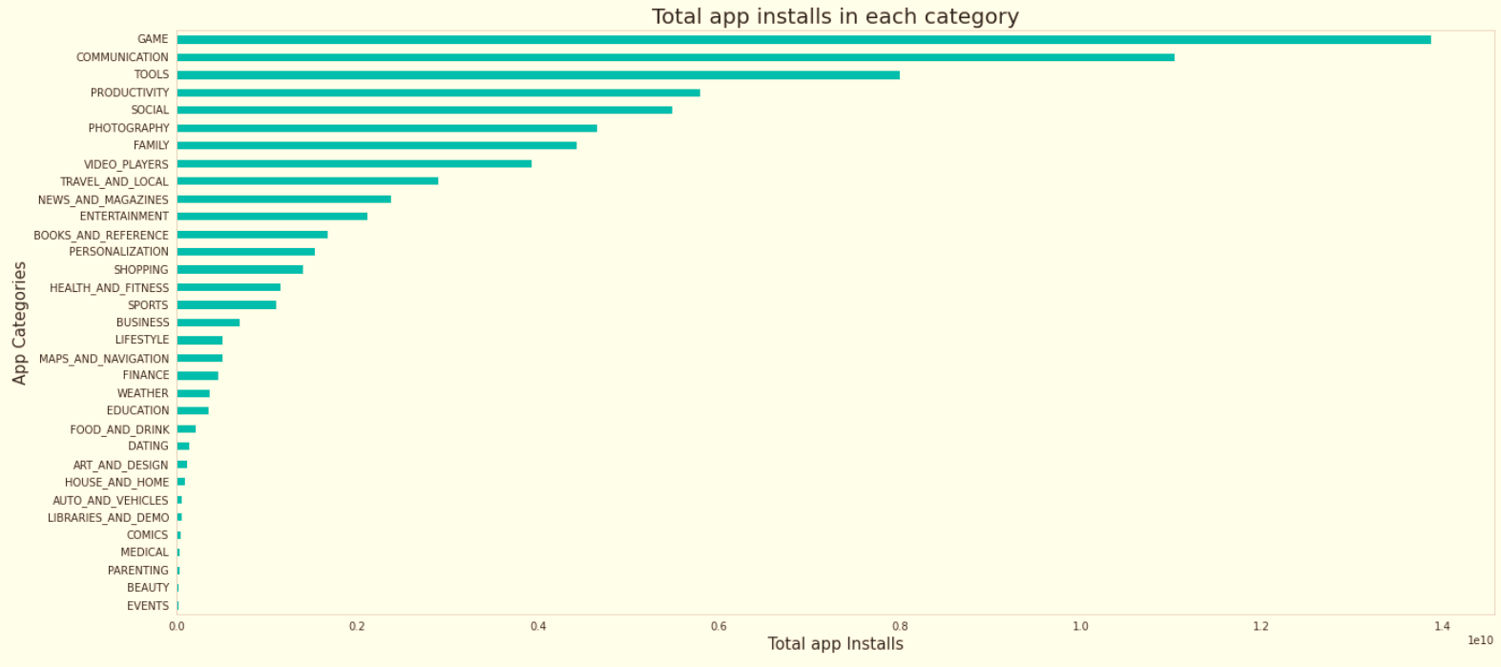
Category App's have most number of installs
The Game, Communication and Tools categories has the highest number of installs compared to other categories of apps.

Slide 18
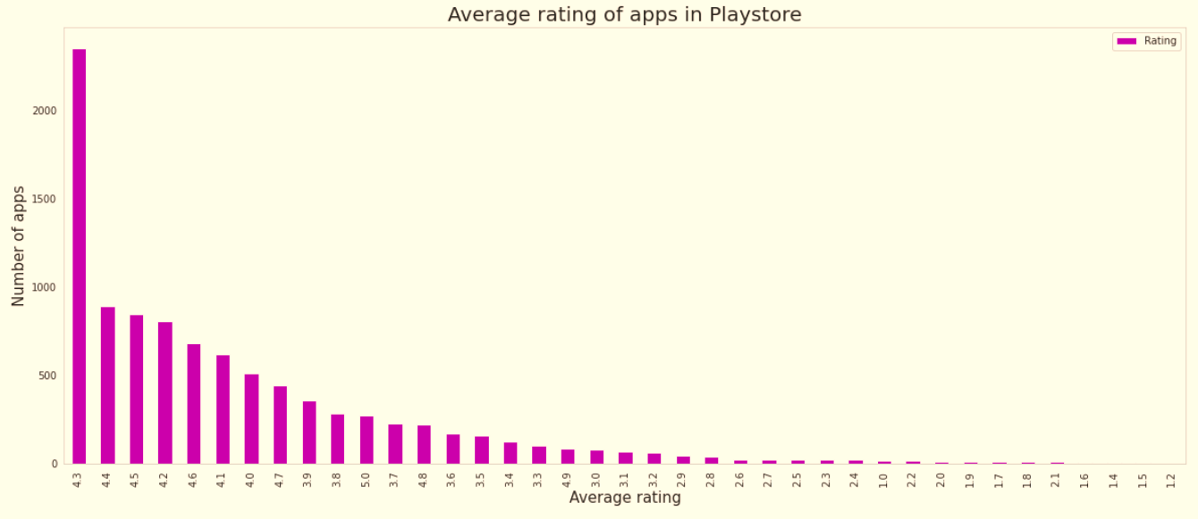
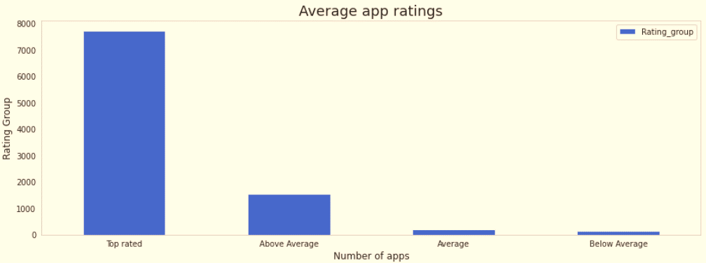
Average rating of the apps
The average user rating is divided into 4 categories:
Rating: 4-5 ⇒ Top Rated
Rating: 3-4 ⇒ Above Average
Rating: 2-3 ⇒ Average
Rating: 1-2 ⇒ Below Average
The majority of the apps in the Play Store (~80%) are top rated.
This implies that the majority of the users are happy with the services received via the respective app.

Slide 19
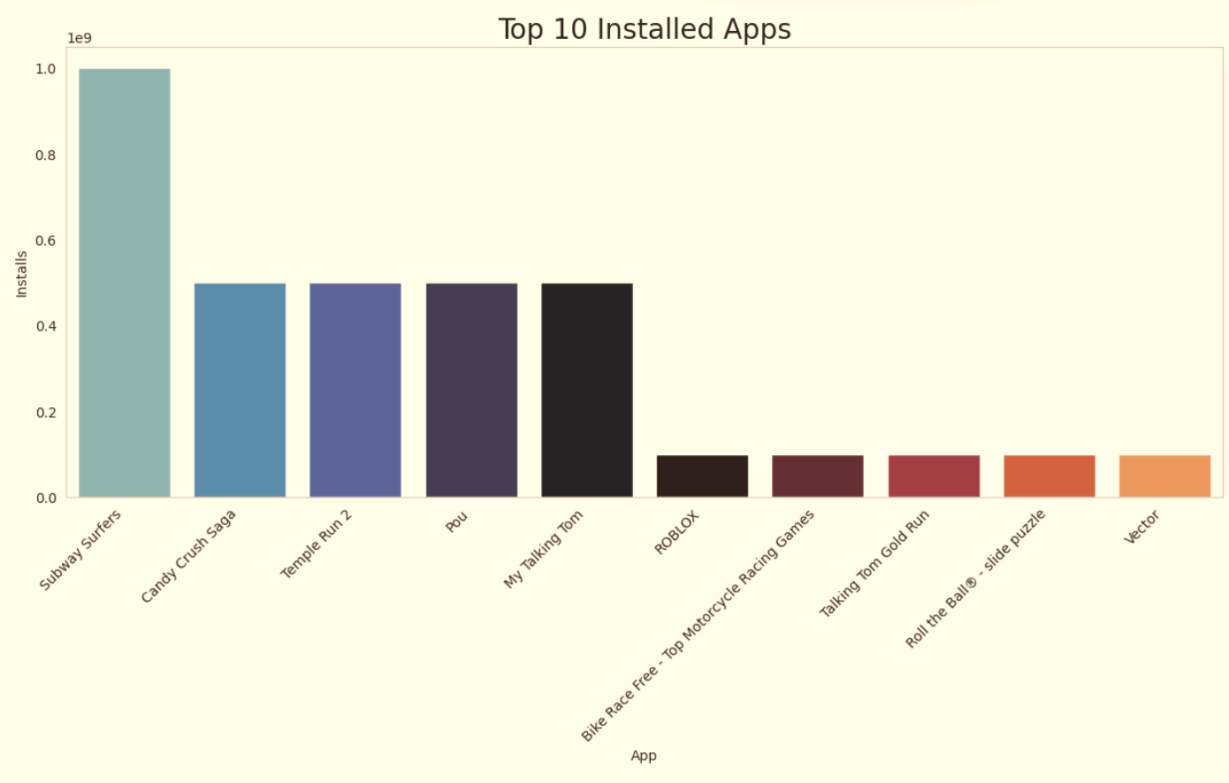
Top 10 installed apps in any category
This graph shows the top installed apps in the ‘Games’ category. Further looking into the play store reveals that these apps are light, casual, single player games.

Slide 20
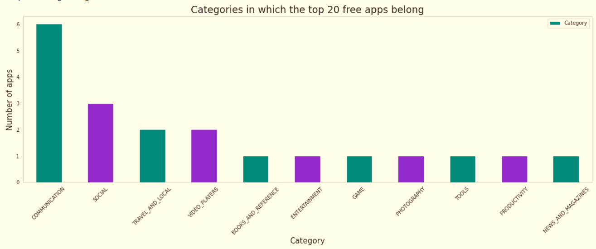
Top Free Apps
There are a total of 20 free apps with over one billion installs.
The top categories in which these apps fall are Communication(6), Social(3), Video Players(2), Travel and Local(2).

Slide 21
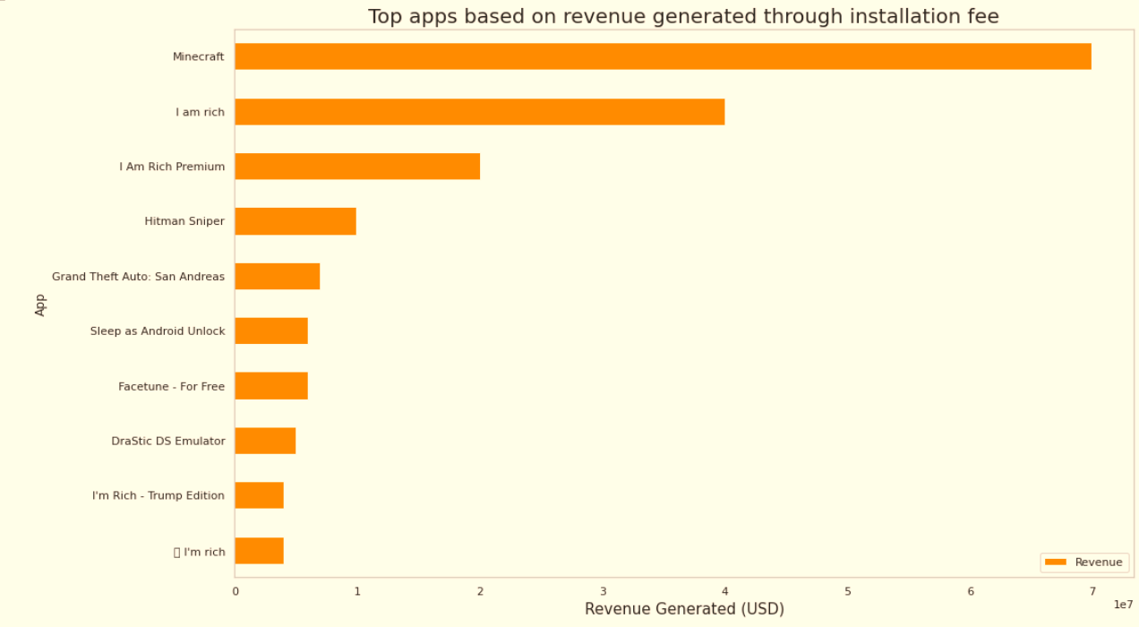
Top Paid Apps Based on Revenue Generated
Revenue generated is given by the formula:
Revenue = Installs * Price
Note that in this case, revenue refers to the money earned only from paid app installs.
The top categories in which these apps fall are Lifestyle(5), Family(5), and Game(4).
Minecraft, I am rich, and I am rich premium are the top paid apps based on revenue generated.
Minecraft is the only app that has over 10 M installs.

Slide 22
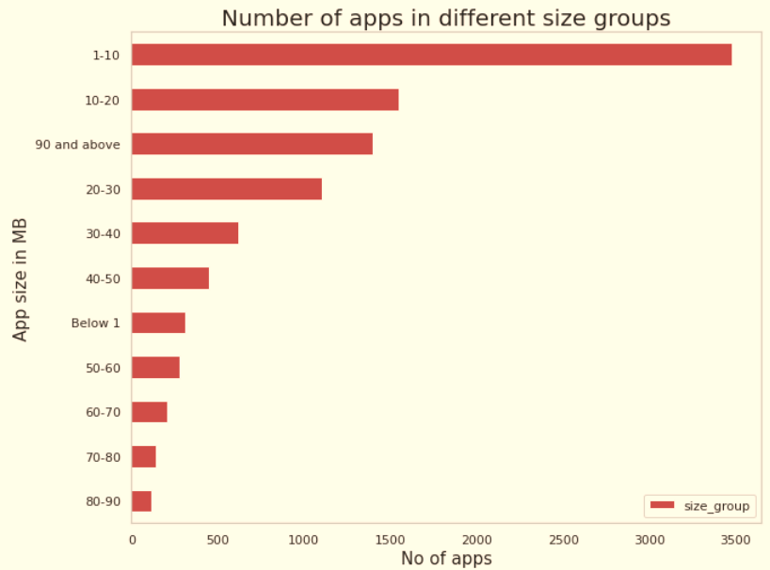
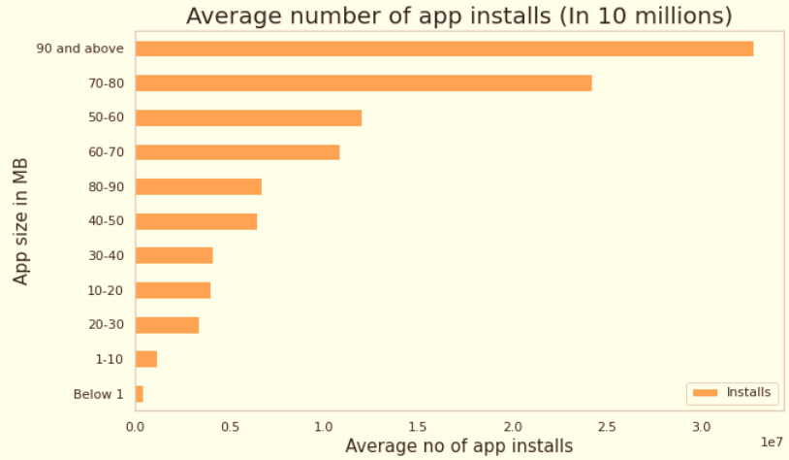
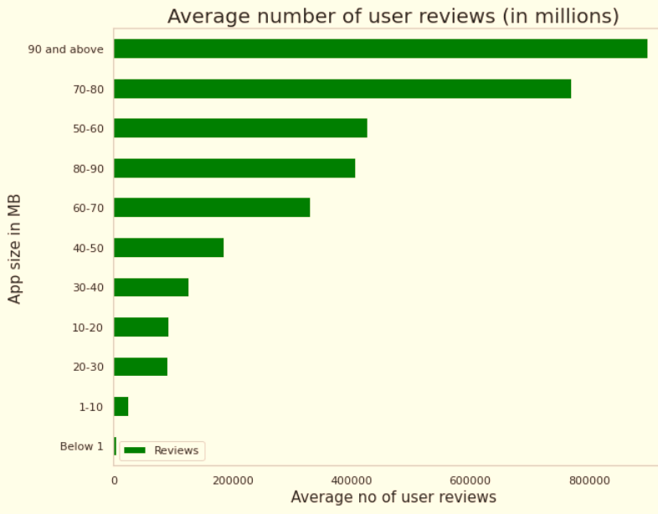
App Size Analysis
The apps are categorized based on its size between
~0 to 100 MB in the intervals of 10 MB each.
The total number of apps in each size category indicates the competition.
Average number of user reviews and average app installs in each size category indicates the popularity of the respective app.

Slide 23
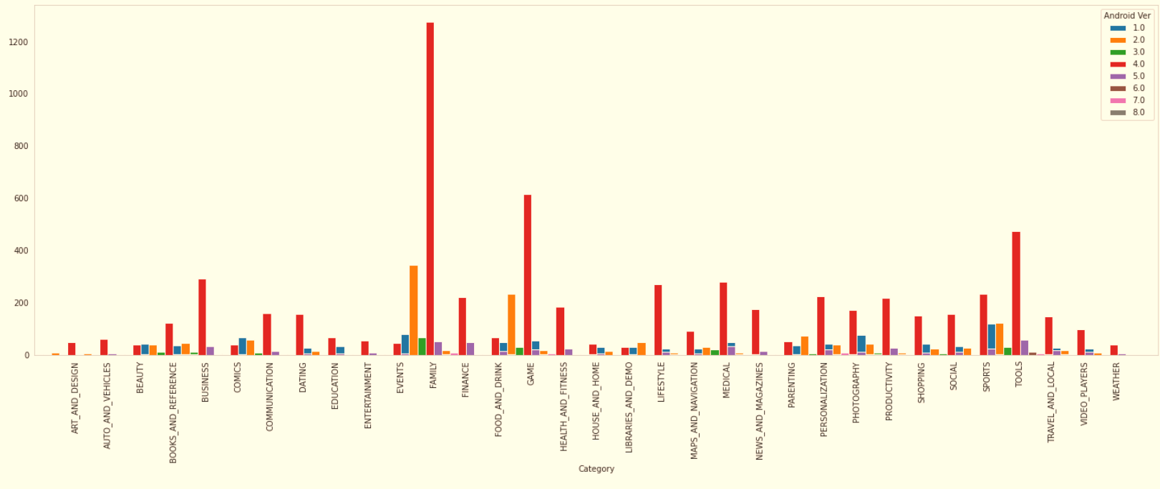
Android version based on each category

Slide 24
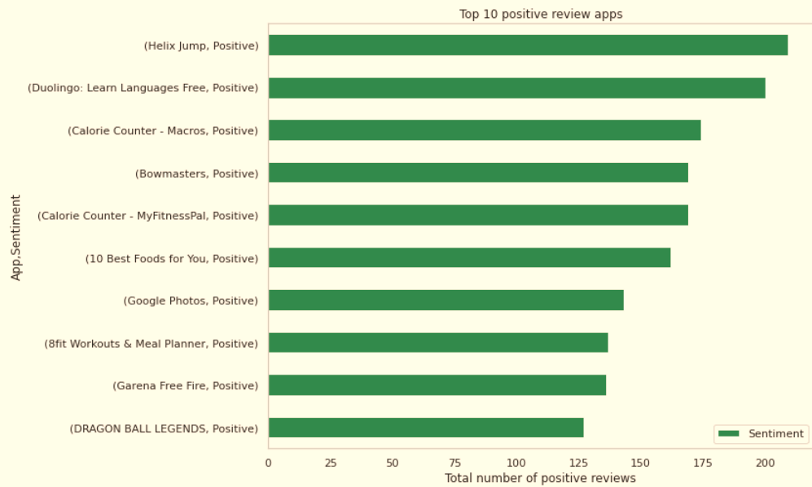
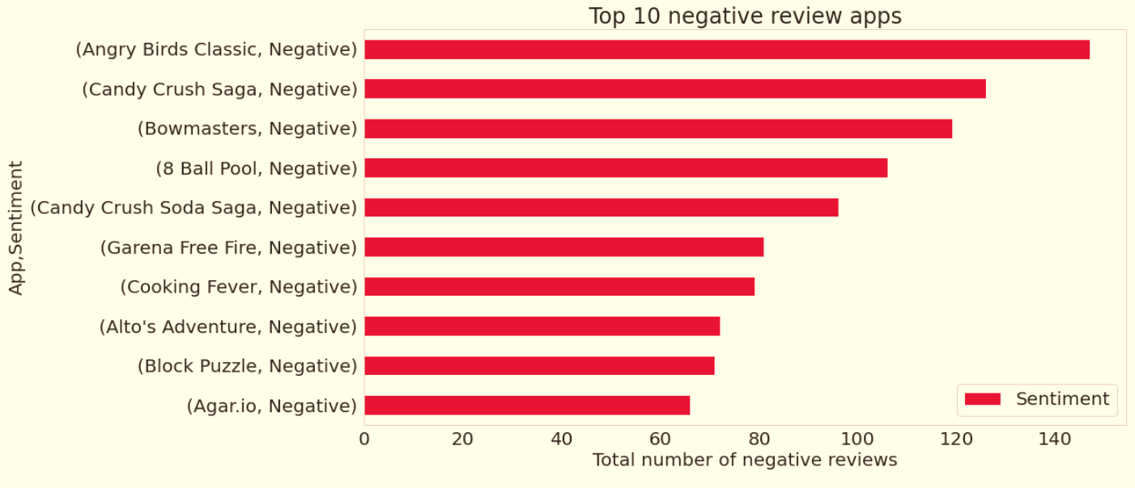
Positive and Negative Reviews
Angry Bird Classic is a app from merged dataset has highest 147 Negative sentiment count.
Helix Jump is a App from merged dataset has highest 209 Positive sentiment count.

Slide 25
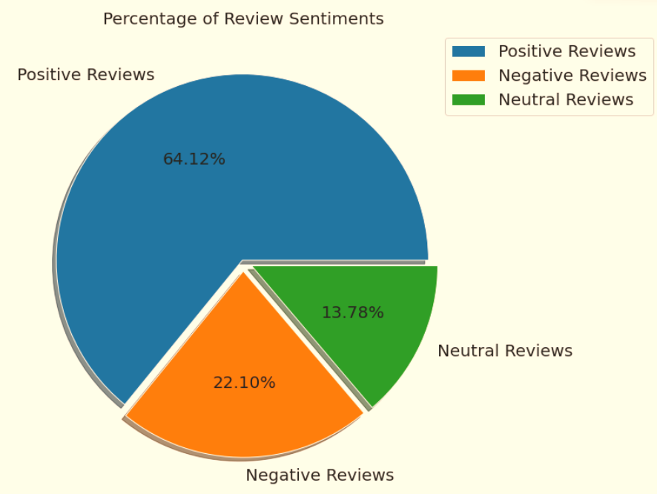
Percentage of Review Sentiments
The number of Unique Apps from Play store and User reviews merged dataset are 816.
From Sentiment column, 64% are Positive, 22% are Negative and 14% are Neutral values.

Slide 26
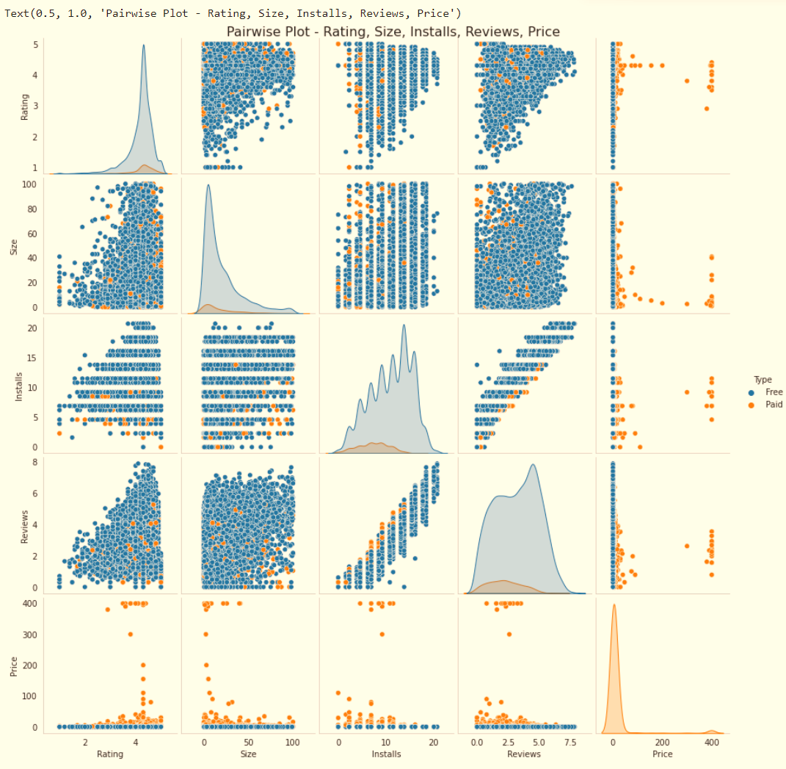
Pairwise Plot- Ratings, Size, Installs, Reviews, Price

Slide 27
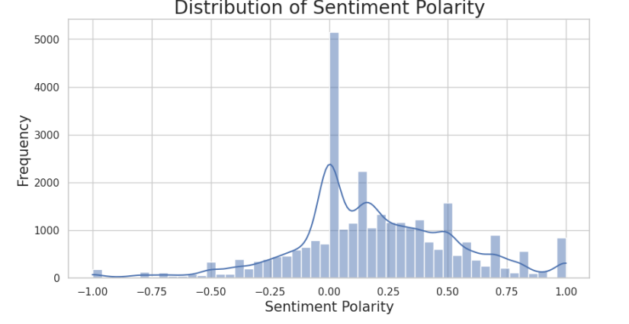
Distribution of Sentiment Polarity
The histogram shows a clear peak towards the positive side, indicating most apps have predominantly positive sentiment amongst users. This suggests most apps are well-received and appreciated by users.

Slide 28
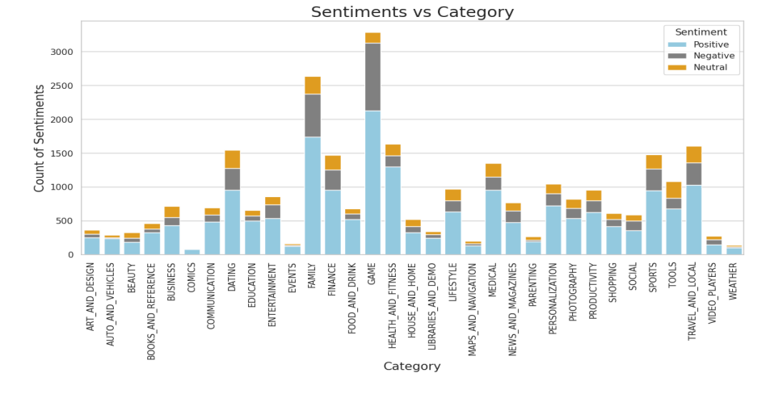
Sentiment counts across categories
The stacked bar chart reveals a complex interplay of positive and negative sentiments across different categories. While people express positive sentiments towards categories like game, family, health and fitness, travel and local, and dating, there is also a notable presence of negative sentiment associated with most of these same categories

Slide 29
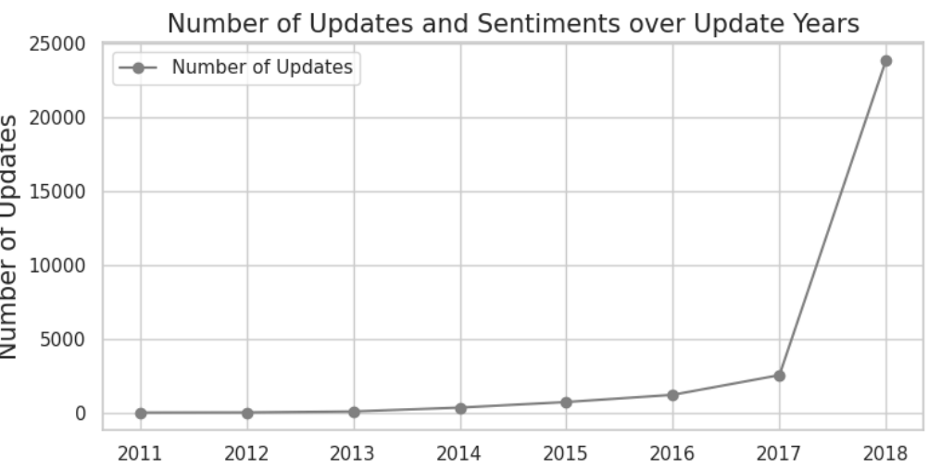
Progression of update counts and the distribution of sentiment counts over time:
A general trend of increasing positive sentiments over time indicates growing satisfaction with received updates.

Slide 30
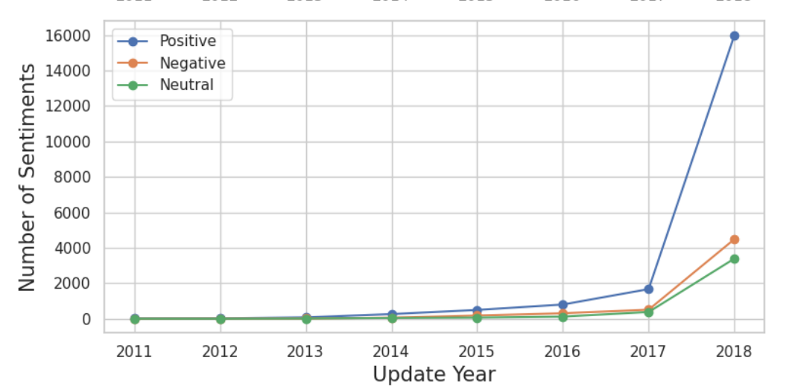
Simultaneously, the increasing number of updates suggests developers are releasing new updates more frequently. Despite this, the number of negative sentiments remains relatively stable, indicating overall satisfaction with the updates received

Slide 31
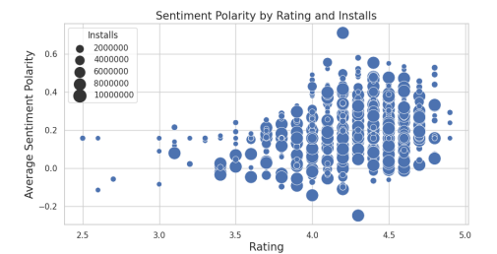
Relationship between Rating, Sentiment Polarity, and Installs:
Higher-rated apps tend to have elevated sentiment polarity, aligning with users leaving positive reviews. Despite lower install counts, some niche apps exhibit high sentiment polarity, reflecting a devoted user base. However, a disparity arises as the most installed apps show lower average sentiment polarity, indicating popularity doesn't consistently correlate with positive user sentiment.

Slide 32
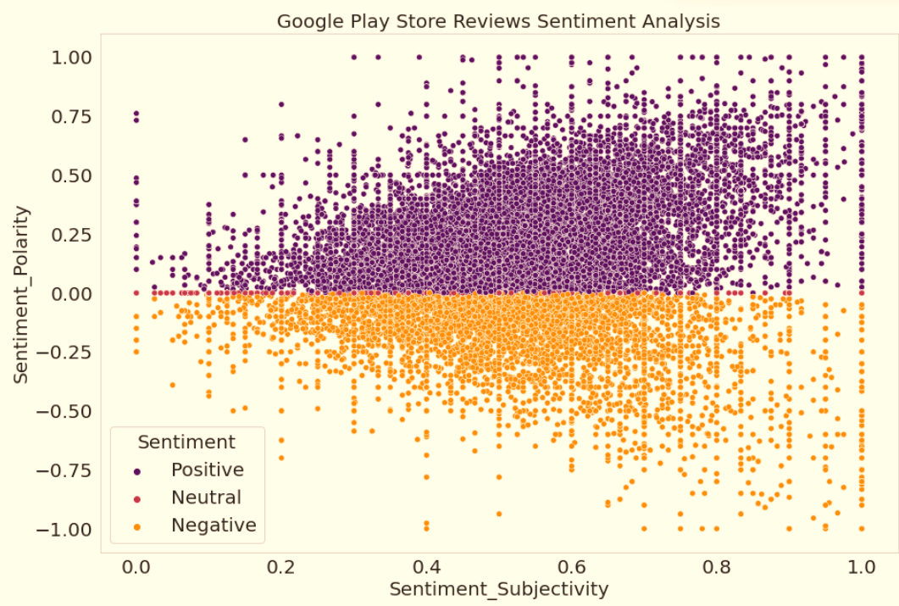
Is sentiment_subjectivity proportional to sentiment_polarity?
From the above scatter plot it can be concluded that sentiment subjectivity is not always proportional to sentiment polarity but in maximum number of case, shows a proportional behavior, when variance is too high or low

Slide 33
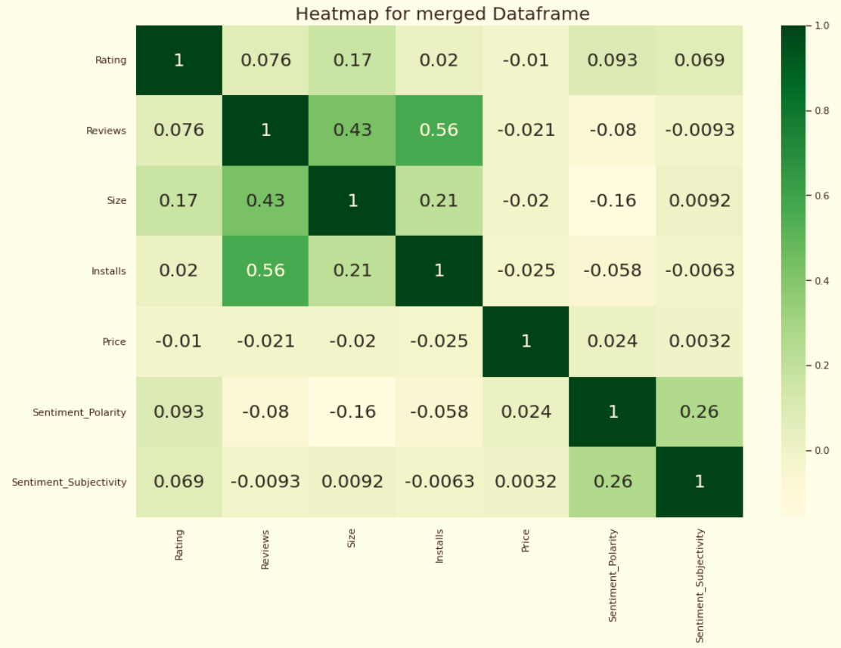
CoRelation in merged data frame
In this correlation matrix, There is not a significant relationship between Rating, Reviews, Size and Installs with respect to the Sentiment polarity and Sentiment subjectivity.

Slide 34
Challenges Faced
Reading the dataset and comprehending the problem statement.
Examining the business KPIs for app development and devising a solution to the problem.
Handling the error, duplicate and NaN values in the dataset.
Designing multiple visualizations to summarize the information in the dataset and successfully communicate the results and trends to the reader.

Slide 35
Conclusion
92.19% apps are Free and 7.81% apps are paid in type.
81.80% apps have Everyone content rating.
Events category has a highest mean rating of 4.39 and Dating category has lowest 4.05 rating.
Family, Game and Tools are top three categories having 1906, 926 and 829 app count.
Most competitive category: Family
Category with the highest number of installs: Game
Tools, Entertainment, Education, Business and Medical are top Genres.
8783 Apps are having size less than or equal to 50 MB.
7749 Apps has rating more than 4.0 including both type of app.
Overall sentiment count of merged dataset in which Positive sentiment count is 64%, Negative 22% and Neutral 14%.

Slide 36
It's good to develop a Free type app and having a content rating for Everyone.
Percentage of apps that are top rated = 81.80%
There are 20 free apps that have been installed over a billion times
Minecraft is the only app in the paid category with over 10M installs, and also has produced the most revenue only from installation fee.
Price, Rating, Size has no or very less correlation with Sentiment Polarity.
The median size of the apps in the play store is 12 MB
The apps whose size varies with device has the highest number average app installs.
The apps whose size is greater than 90 MB has the highest number of average user reviews, ie, they are more popular than the rest.
Helix Jump has the highest number of positive reviews and Angry Birds Classic has the highest number of negative reviews.

Slide 37
Future Scope
Strategic Development in Popular Genres: Acknowledge the popularity of certain genres, such as Tools, Action, Photography, and Entertainment. Consider investing in or refining apps within these genres to align with user preferences and maximize engagement
Strategic Revenue Generation: Consider app development or improvements in categories that generate higher revenue, such as Lifestyle, Finance, and Weather. Evaluate user preferences within lower-revenue categories to identify opportunities for enhancement.
Address Negative Feedback: Investigate apps with negative sentiment to pinpoint specific issues causing dissatisfaction. Prioritize improvements in areas highlighted by negative sentiment to enhance user satisfaction and overall app performance
Compatibility with Latest Android Versions: Given the correlation between higher revenue and compatibility with newer Android versions, prioritize app development and updates for the latest versions of the Android operating system.

Slide 38
REFERENCES
[1]. https://youtu.be/rnUXI3A5ds8?si=vgFdkl21sZVEp6XU
[2]. https://www.kaggle.com/datasets/lava18/google-play-store-apps
[3]. https://github.com/Datawithabhishek/Google-Play-Store-Data-Analysis

Slide 39
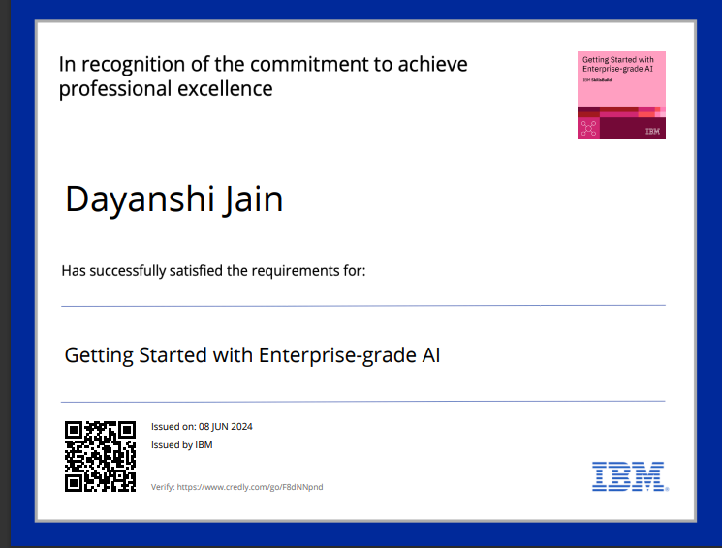
COURSE CERTIFICATE 1

Slide 40
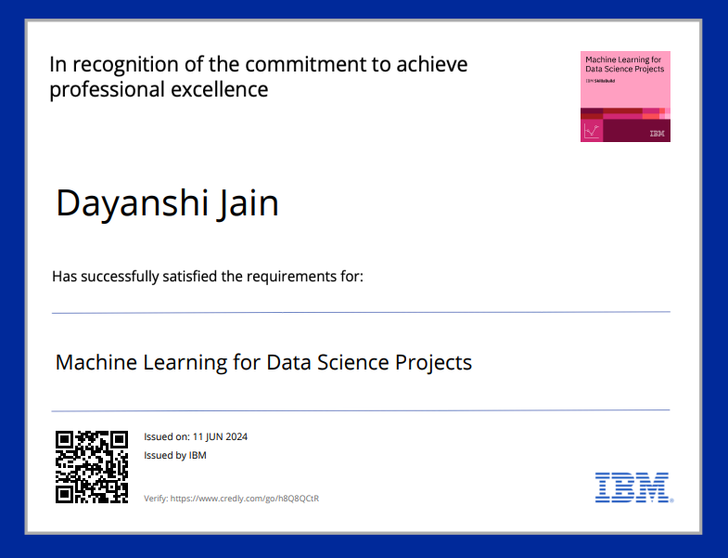
COURSE CERTIFICATE 2

Slide 41
THANK YOU

